Slide 1
Intro to Neural Nets
Week 7: Interpretable ML for Neural Networks

Slide 2

Today’s Agenda
Blackbox Models
Tension between interpretability and performance.
Shapley Values
Cooperative game-theory and idea behind Shapley values.
SHAP Library
How we apply Shaply values to ML models.
LIME
Alternative technique for estimating features’ marginal effects.

Slide 3
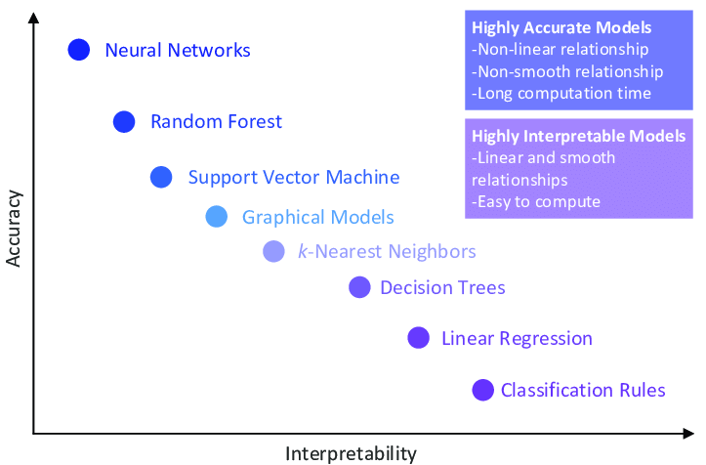
Tension: Interpretability vs Performance

Slide 4
Shapley Values
Wikipedia:
The Shapley value is a solution concept in cooperative game theory. It was named in honor of Lloyd Shapley, who introduced it in 1951 and won the Nobel Prize in Economics for it in 2012. To each cooperative game it assigns a unique distribution (among the players) of a total surplus generated by the coalition of all players. The Shapley value is characterized by a collection of desirable properties.
More Simply:
What is the marginal contribution of each player across all possible coalitions?

Slide 5

Note on Game Theory
Background:
Two main types of games: non-cooperative and cooperative. Non-cooperative games involve competing players, whereas cooperative involve collaboration for mutual benefit.
Some games involve competitions between coalitions.

Slide 6
Game? Players? Payoff?
Link to Machine Learning Models
The analog for these notions in ML is as follows:
The game: the prediction task.
The players: feature / predictor values.
The total surplus (payoff): the predictions the model yields under a particular coalition (combination) of feature values.
Let’s work through a simple example in a traditional cooperation context, and then come back to the machine learning models.
Notes:
This is straight forward to think about in the context of binary indicators (something is true, versus it’s not true). But, often we have features that take on continuous values, where it’s not a matter of if they are present or not, it’s a matter of whether the particular value is present or not. It would be impossible to brute force over infinite real values. Even with categorical variables, it can get quite computationally expensive. So, we end up using monte carlo techniques, simulating / sampling.

Slide 7

Shapley Value Example
Escape Room:
Imagine we have three players: A, B, and C, who decide to spend the weekend playing several different escape rooms around the city. The players participating in each room vary, however, because each has some errands to run over the course of the day.
The players earn a reward (payoff) for completing an escape room, and they then share the proceeds. The faster the players complete a room, the more money they earn. It is quite likely that the players do not contribute equally to the task. Some players probably have more experience than others, they know the subject matter matter for the puzzles in any given escape room, or they may just be more (less) interested in the game.
How should we split the reward between the players?

Slide 8
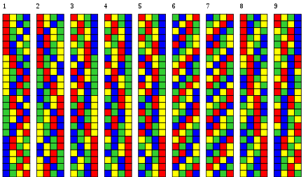
Shapley Value Example
Coalitions and Payoffs:
When playing alone:
A: $80
B: $56
C: $70
When playing in pairs:
A + B: $80
A + C: $85
B + C: $72
When all together:
A + B + C: $90

Slide 9

Shapley Value Example
Examples of Average Marginal Contribution:
A plays alone = $80 (marginal contribution of A = $80)
B joins A = $80 (marginal contribution of B = $0)
C joins A and B = $90 (marginal contribution of C = $10)
A plays alone = $80 (marginal contribution of A = $80)
C joins A = $85 (marginal contribution of C = $5)
B joins A and C = $90 (marginal contribution of B = $5)
Simply Put:
We look at all permuted sequences of players, and then average over the resulting marginal contributions.

Slide 10
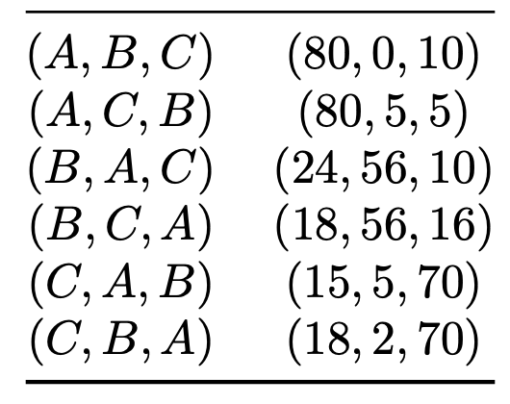
Shapley Value Example
Average of Marginal Contributions:
When we average over each player’s marginal contributions (note, on the right, the marginal payouts are ordered by A, B, C)…
… we find that A contributes an average of (80 + 80 + 24 + 18 + 15 + 18) / 6 = 39.167, B contributes an average of 20.667, and C contributes an average of 30.167. These are our payoff weights, e.g., A contributes ~ twice as much as B.

Slide 11
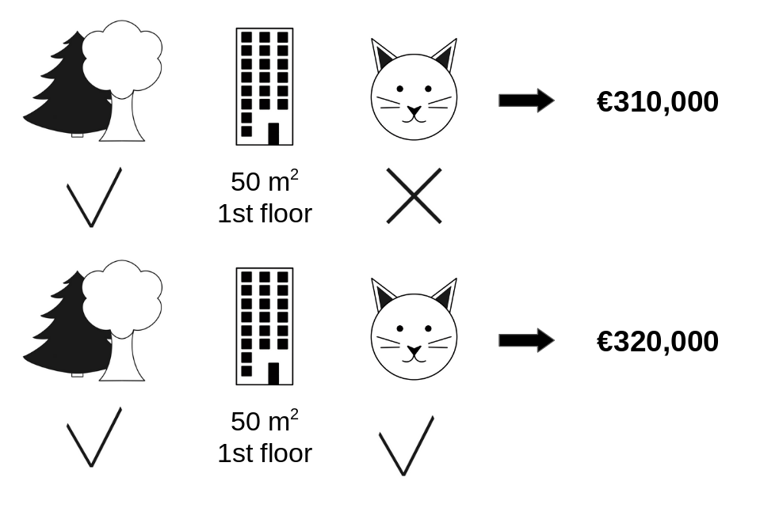
SHAP: SHapley Additive exPlanations
Prediction Scenario:
We have a machine learning model that predicts some label.
We have many games, i.e., the predictions the model produces for each observation.
We thus have different coalitions of players, i.e., combinations of feature-values.
Note that the average marginal contribution for a feature could be negative here.
Notes:
Imagine we have a model for predicting apartment value, which has a handful of features. Near greenspace, what floor we are on, square footage, and whether pets are allowed. The average prediction across the entire sample of data is 310,000 EUR. Our permutations of coalition members here would be based on something like, near green space versus not, floors 0-9, binned square footage values, and cat or not.

Slide 12
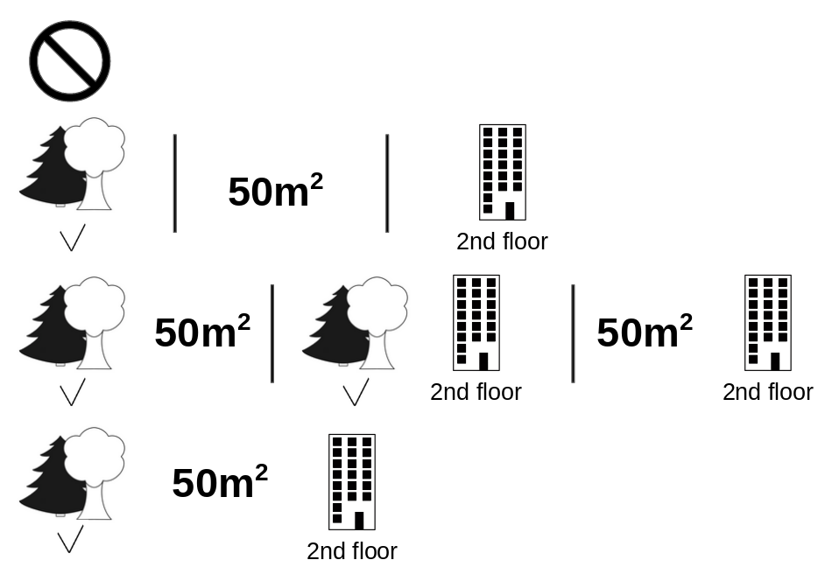
SHAP: SHapley Additive exPlanations
Procedure – Marginal Contribution of ‘Pets Allowed’:
We can cycle through all permutations of feature-values, just like in the escape room example.
For a given feature value, we can randomly replace it with some other value from the data. Additionally, we can randomly replace other feature values with alternatives from the data.
If we consider enough ‘counterfactuals’, we gain a sense of how ‘moving across a feature’s values’ affects the marginal prediction, under many combinations of other feature values (partners).

Slide 13
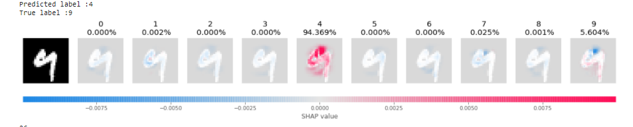
SHAP: SHapley Additive exPlanations
Marginal Contribution of a Pixel:
In a CNN, our input predictors are pixels. We can do the same thing here using pixel values.
We can figure out a Shapley value for a particular pixel position, in a particular color channel, for feature values that range from 0 to 255.
To simplify the problem, we might also work with super-pixels (group pixels, averaging their feature-values).

Slide 14
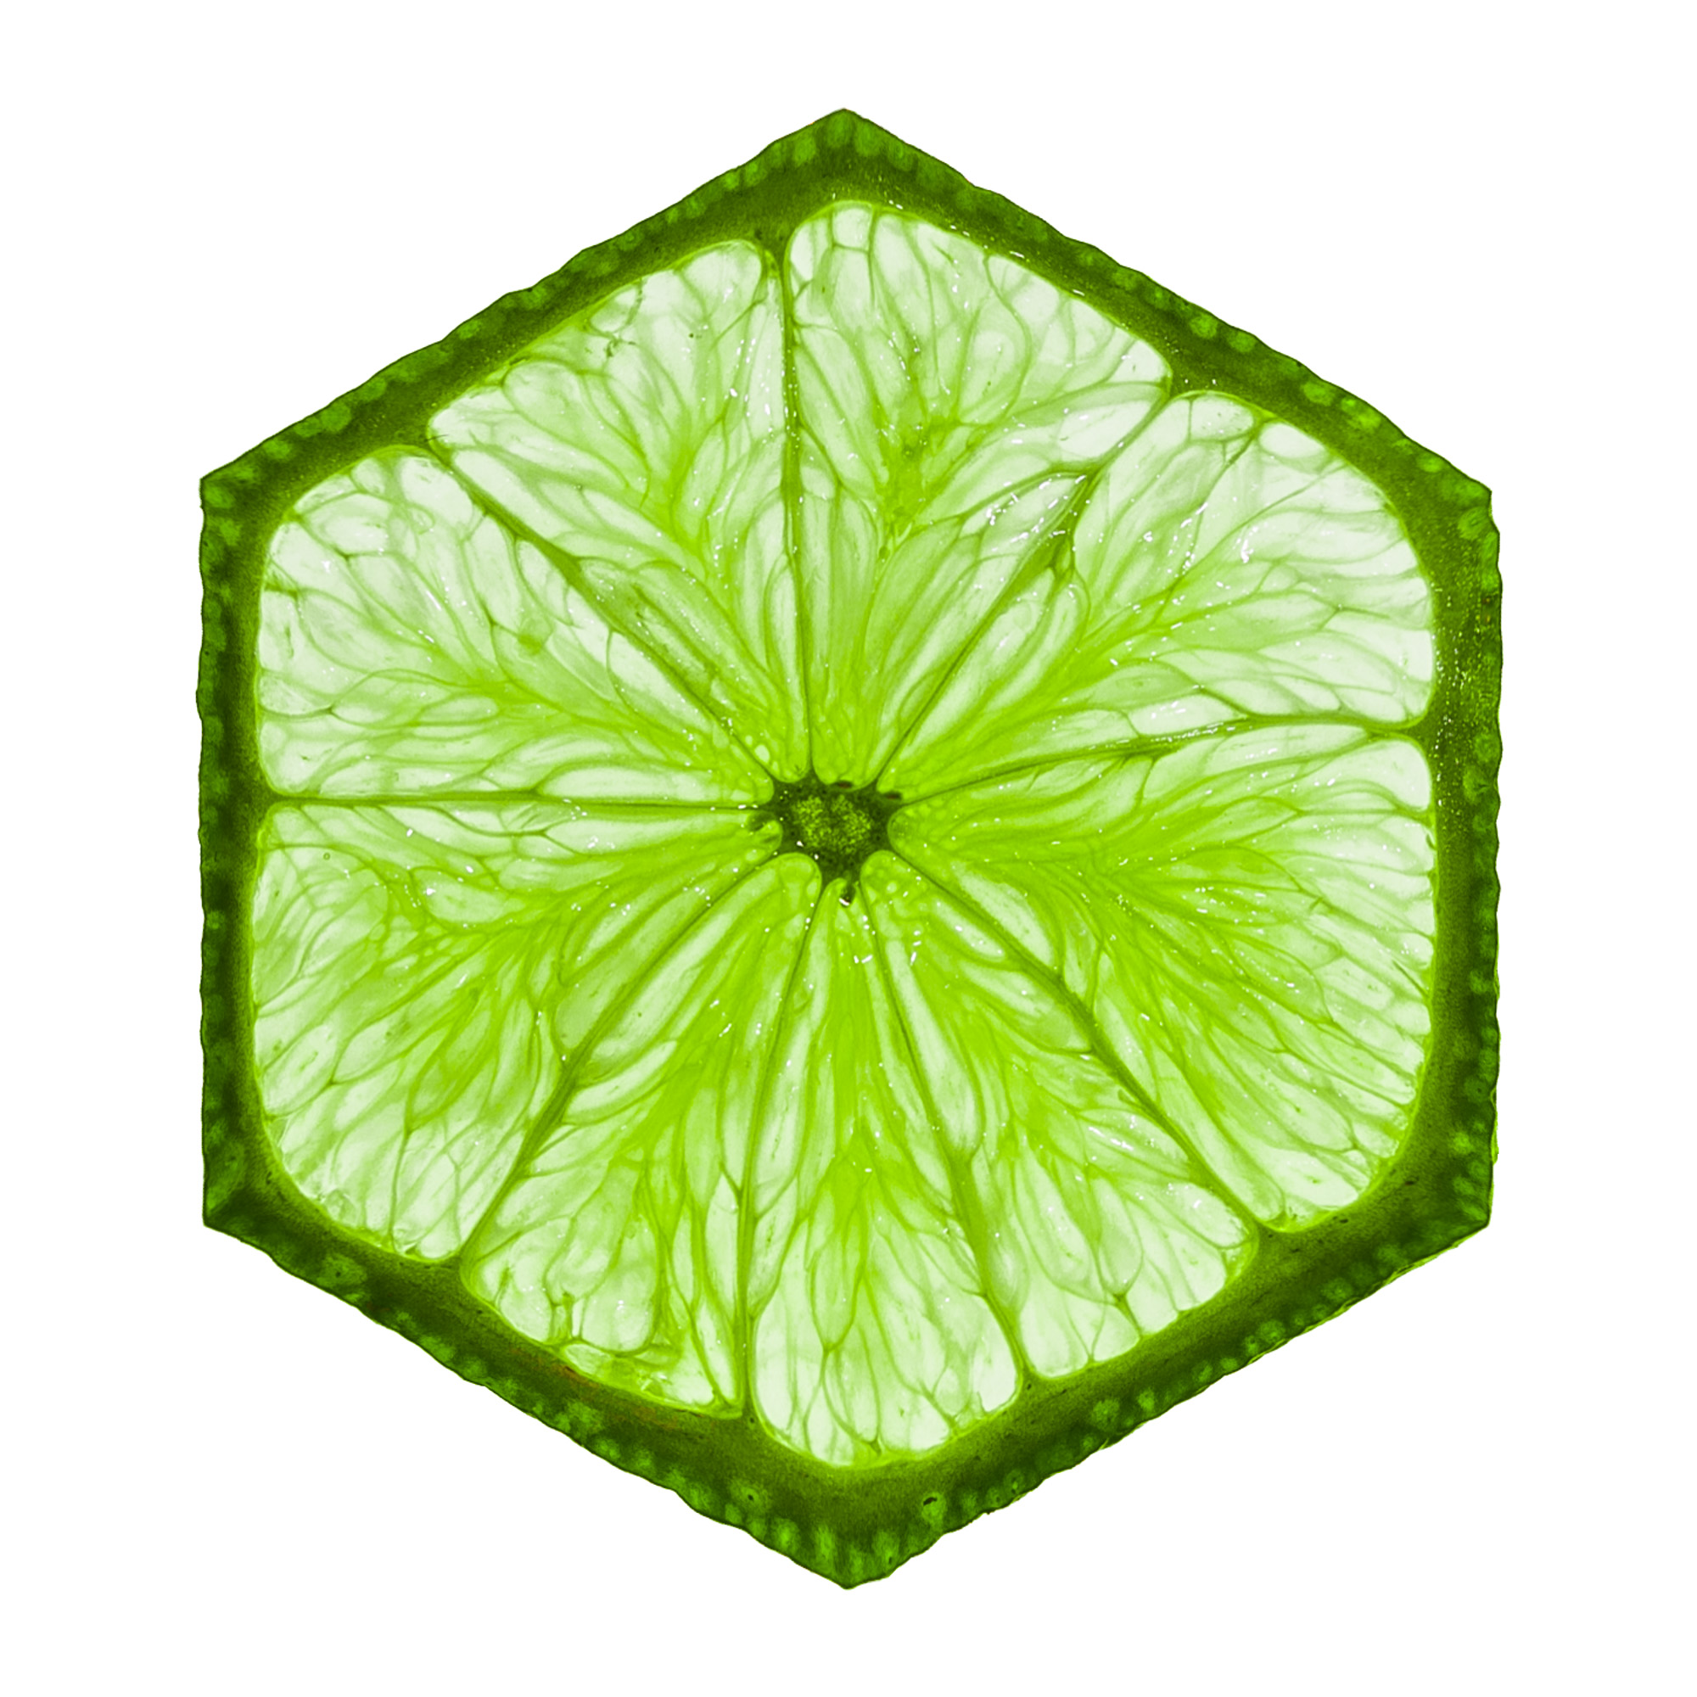
Local Interpretable Model-agnostic Explanations
Procedure – Local Perturbations of the Data:
We assume that a features’ contributions to the prediction can be locally approximated by a linear regression. Then:
For a given prediction, randomly perturb the observation (modify its feature values), repeatedly, and recover the associated predictions for each synthetic observation.
This procedure yields an observation-specific dataset. Use the dataset to estimate a weighted linear regression on the dataset, weighting observations inversely by their distance / dissimilarity from the original observation.
Beta coefficients reflect features’ localized marginal contributions to the prediction.
Notes:
https://www.oreilly.com/content/introduction-to-local-interpretable-model-agnostic-explanations-lime/

Slide 15
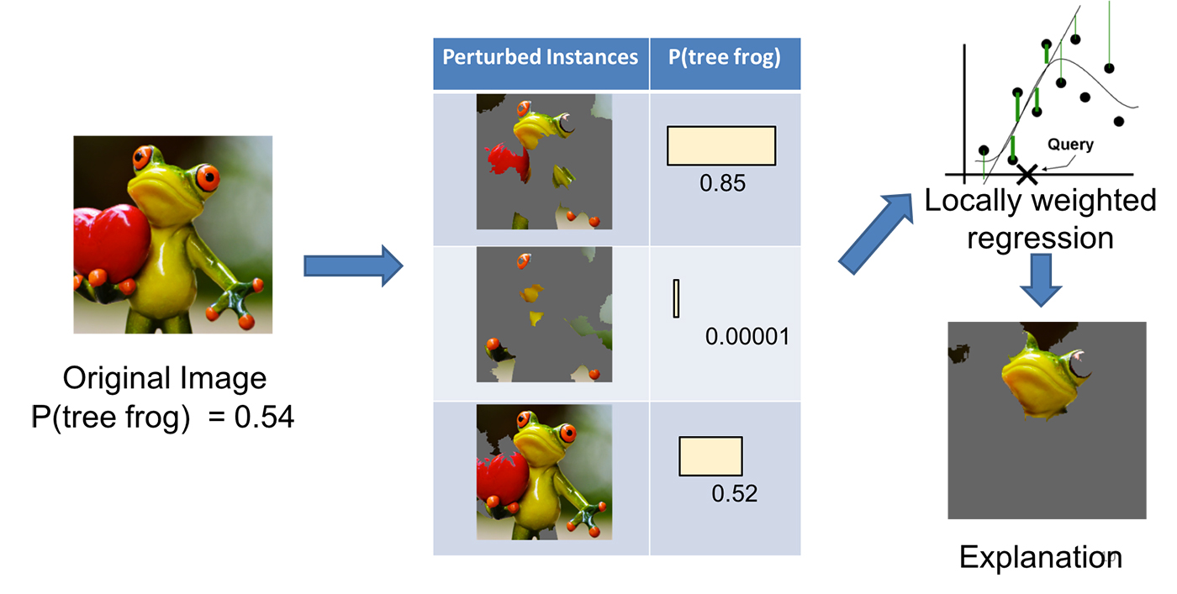
Local Interpretable Model-agnostic Explanations
Notes:
https://www.oreilly.com/content/introduction-to-local-interpretable-model-agnostic-explanations-lime/

Slide 16
Questions?
Notes:
Weights are not initialized until you “build” the model (or compile it, which will first build).

